Slide 1
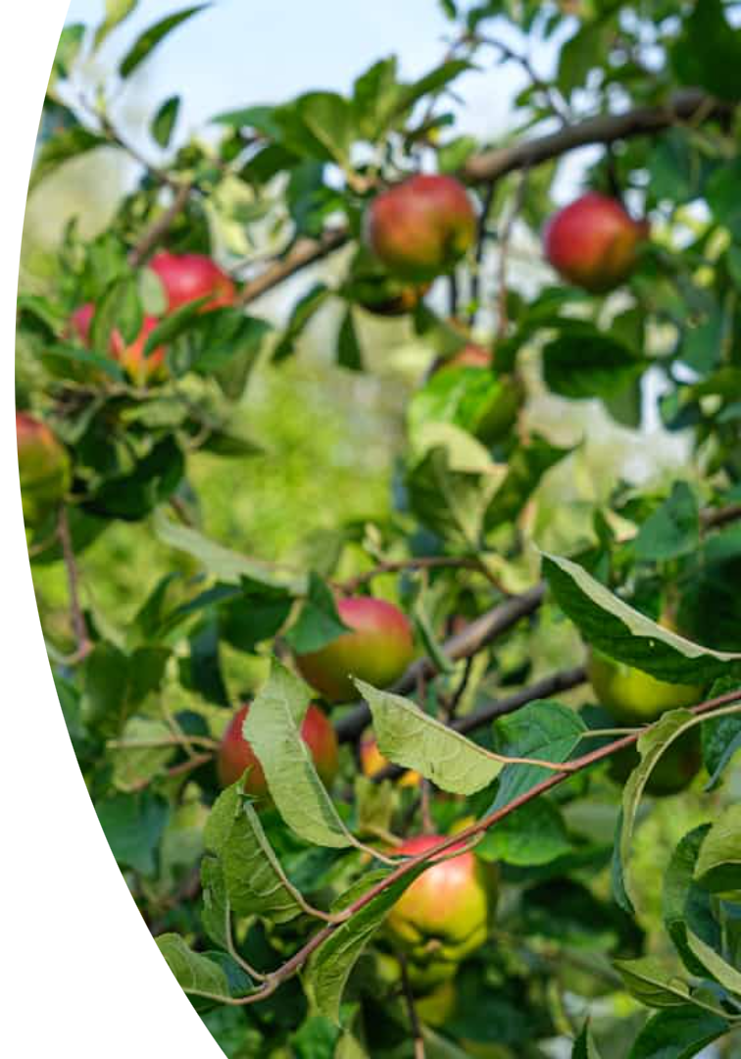
Binary Classification of Apple-Leaf Diseases
Group 6: Shaheryar & Feruz • NCML 2025

Slide 2
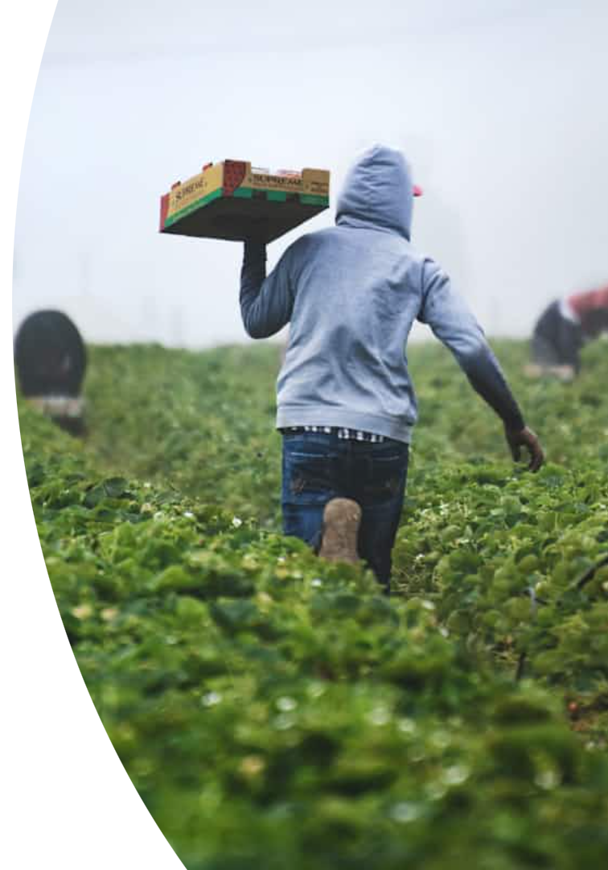



Why It Matters
Disease Impact
Manual Limitations
Reduces yield and quality.
Slow and subjective inspection.
Our Objective
Fast, binary "Healthy vs Diseased" prediction.

Slide 3
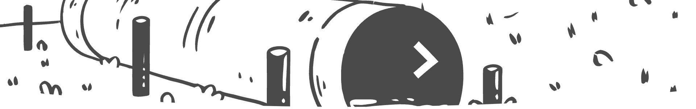




Dataset Pipeline
Data Source
PlantVillage: 50k images, 35 classes.
Filtering & Merging
Apple leaves only; Rust + Powdery → "Diseased."
Splitting
70% train, 15% validation, 15% test.
Imbalance Handling
Augmentation for 864 Diseased vs. 458 Healthy.

Slide 4

Baseline Attempts
Logistic Regression
K-Means Clustering
44% accuracy on pixels.
NMI 0.67 on CNN embeddings, weak clusters.
Single-head Multi-class CNN
94% accuracy, but overkill for binary.

Slide 5
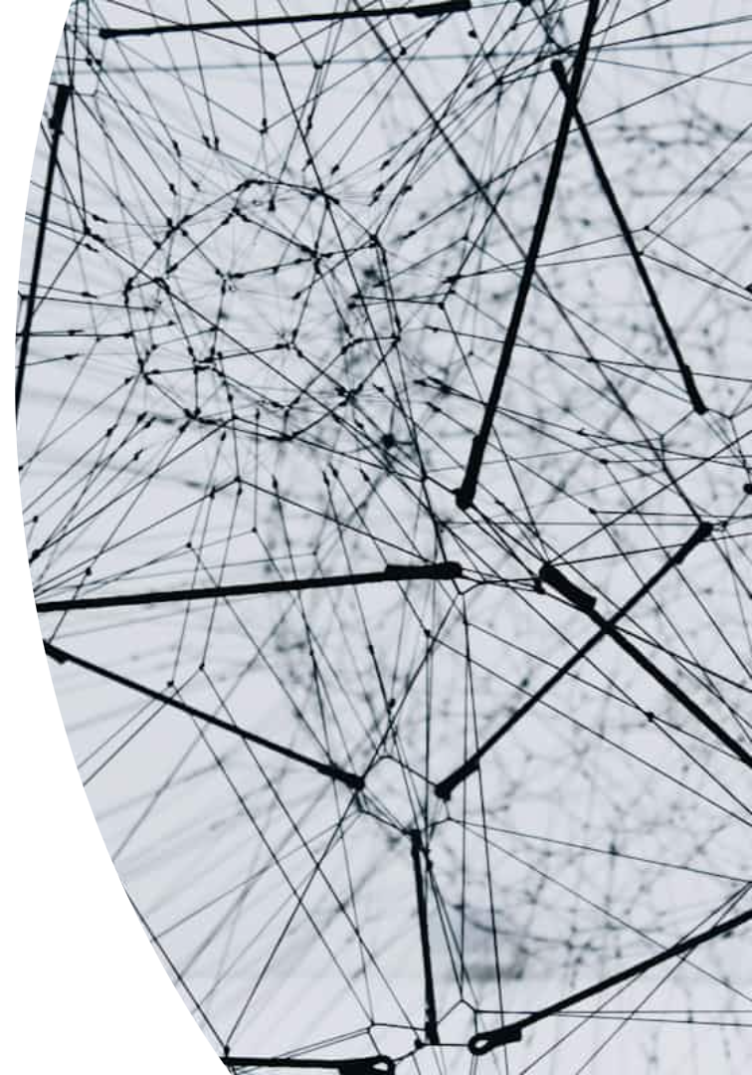
Final Model Architecture
Base Model
ResNet-18 pretrained on ImageNet.
Output Layer
Replaced with 1 logit (sigmoid).
Training Configuration
Loss: BCEWithLogits; Optimizer: Adam 1e-4.
Execution
5 epochs on Tesla T4, batch size 32. Code on GitHub.

Slide 6
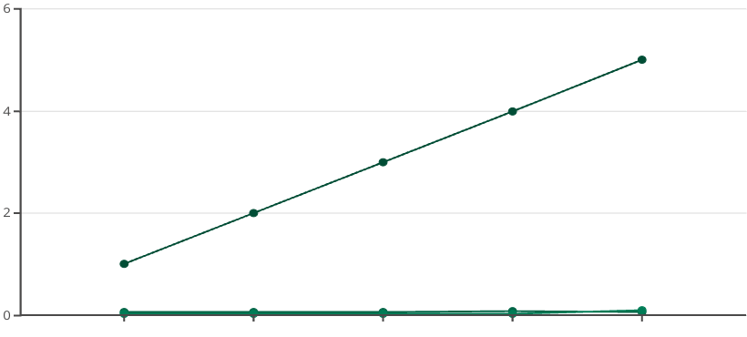
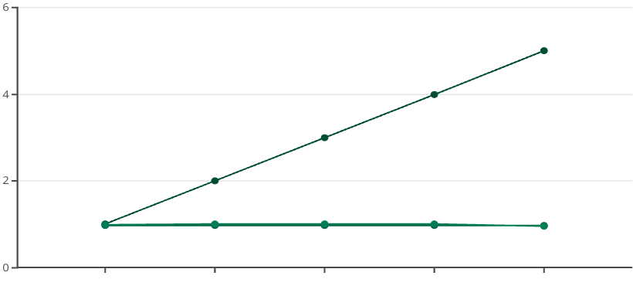
Training Progress – 5 Epochs
Loss Over Epochs
Accuracy Over Epochs
Epoch
Train Loss
Validation Loss
Epoch
Train Accuracy
Validation Accuracy
Loss and accuracy trends for training vs. validation over five epochs.

Slide 7
Test-Set Results
Overall Accuracy
Healthy Recall
Diseased Recall
96%
100%
94%

Slide 8
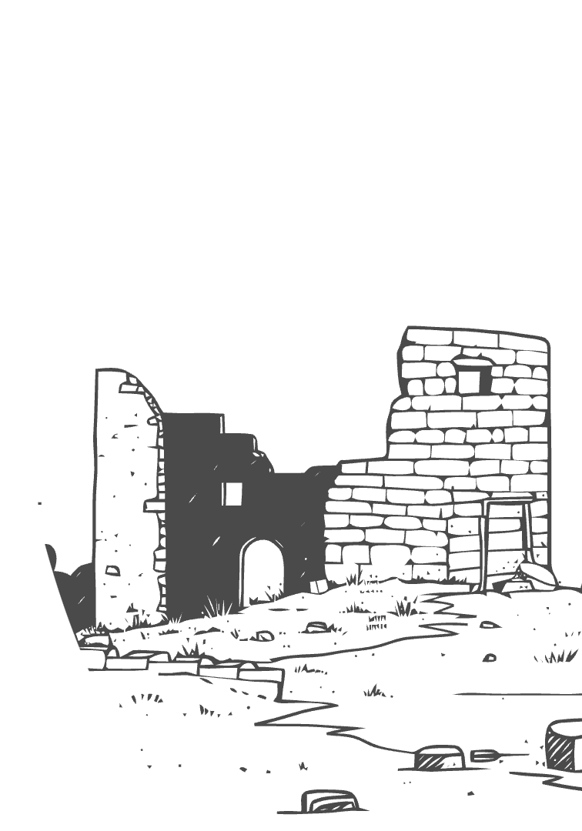
Abandoned Ideas & Lessons
Attempt
Why Dropped
MLP Baseline
No spatial features
K-Means
Poor separation
Single-head CNN
Unnecessary classes
Two-head CNN
99% val but poor generalization
UMAP plot shows nice species clusters, implying the model learned, but some approaches were over-engineered.

Slide 9
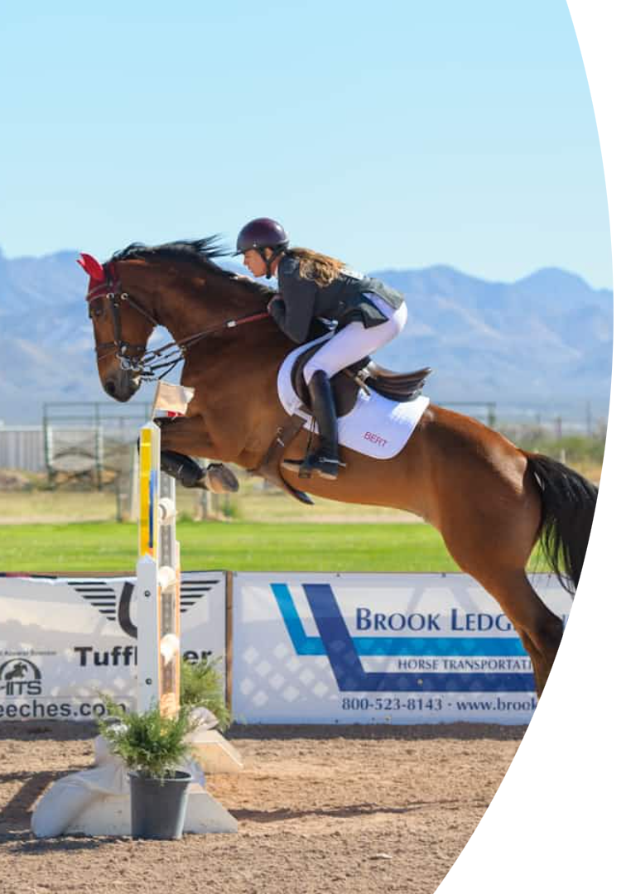



Limitations & Next Steps
Dataset Size
Overfitting
Small dataset with mild class imbalance.
Observed after 4-5 epochs.
Future Work
Multi-disease labels, MobileNet deployment, SHAP/LIME explanations.

Slide 10
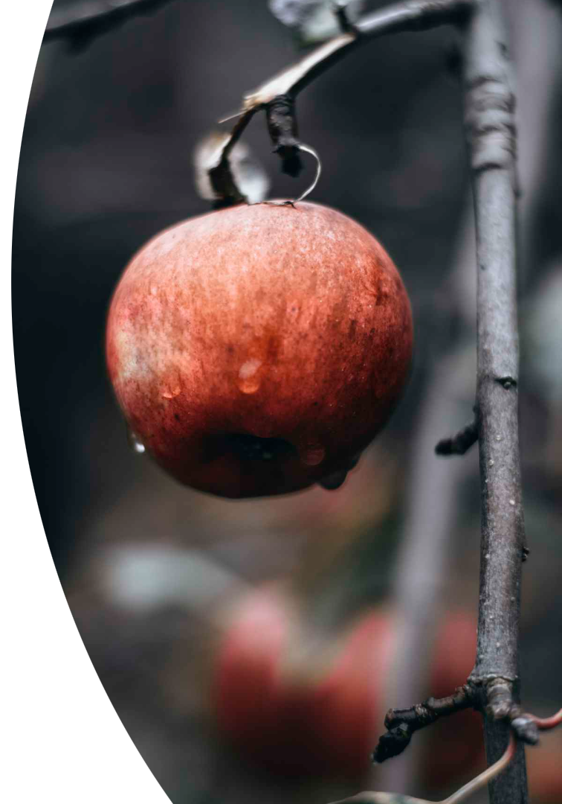
Take-Home Message
A lightweight, transfer-learned ResNet achieves 96% accuracy on apple-leaf health with ~1k images. This provides a practical early-warning tool for orchards.
Live demo of earlier prototype: https://plantdiseasencml.vercel.app/

